Slide 1
JPA : Entity Life Cycle
Priyanka Sarode

Slide 2
Index
Persistence Context
Entity Lifecycle
Practical
JPQL
Practical

Slide 3
JPA Runtime Overview
Application
Persistence Context
Entity Manager
Object1
Object2
Object1
Database
Object2
Managed Entities

Slide 4
Persistence Context
Entity Manager:
The EntityManager is the primary interface used by application developers to interact with the JPA runtime.
Persistence Context:
Persistence context defines a scope under which particular entity instances are created, persisted, and removed.
Persistence context is to manage the entity lifecycle in an application.
Every EntityManager manages its own persistence context. In short, persistence context is a memory area for EntityManager to work on entity instance.
The persistence context is the first-level cache where all the entities are fetched from the database or saved to the database. It sits between our application and persistent storage.

Slide 5
Persistence Context
Persistence context keeps track of any changes made into a managed entity. If anything changes during a transaction, then the entity is marked as dirty.
When the transaction completes, these changes are flushed into persistent storage.
The EntityManager is the interface that lets us interact with the persistence context. Whenever we use the EntityManager, we are actually interacting with the persistence context.
If every change made in the entity makes a call to persistent storage.
A persistence context is a set of entity instances in which for any persistent entity identity there is a unique entity instance. Within the persistence context, the entity instances and their lifecycle are managed.

Slide 6
Entity Life Cycle
Object/Entity managed by ORM by using EntityManager passes through different stages during its persistence.
Detached
Database
Doesn't Exists
New
Managed
Removed

Slide 7
New/Transient State
When an entity object is initially created its state is New. In this state the object is not yet associated with an Entity Manager and has no representation in the database.
a newly instantiated entity object is called transient. The entity hasn’t been persisted yet, so it doesn’t represent any database record.
Detached
Student s1 = new Student()
Database
Doesn't Exists
New
Managed
Removed

Slide 8
Managed State
Managed State : An entity object becomes Managed when it is persisted to the database via an EntityManager’s persist method which must be invoked within an active transaction. On transaction commit, the owning Entity Manager stores the new entity object to the database.
The managed state is maintained by below three methods:
1. EntityManager.persist(s1);
2. EntityManager.find()
3. EntityManager.flush()
Detached
persist(s1)
flush()
Database
Doesn't Exists
New
Managed
find()
Removed

Slide 9
Detached State
The entity instance is an instance with a persistent identity that is no longer associated with a persistence context, usually because the persistence context was closed or the instance was evicted from the context.
This state represents entity objects that have been disconnected from the EntityManager. For instance, all the managed objects of an EntityManager become detached when the EntityManager is closed.
Detached
Persistence Closed
detach(s1)
Database
Doesn't Exists
New
Managed
Removed

Slide 10
Removed State
A managed entity object can also be retrieved from the database and marked for deletion, by using the EntityManager’s remove method within an active transaction. The entity object changes its state from Managed to Removed, and is physically deleted from the database during commit.
Detached
flush()
Database
Doesn't Exists
New
Managed
remove(s1)
Removed

Slide 11
Practical Demo
JPA Entity Life Cycle

Slide 12
JPQL : Java Persistence Query Language
Priyanka Sarode
05-03-2022

Slide 13
JPQL
The JPQL (Java Persistence Query Language) is an object-oriented query language which is used to perform database operations on persistent entities. Instead of database table, JPQL uses entity object model to operate the SQL queries. Here, the role of JPA is to transform JPQL into SQL. Thus, it provides an easy platform for developers to handle SQL tasks.
JPQL is an extension of Entity JavaBeans Query Language (EJBQL), adding the following important features to it: -
It can perform join operations.
It can update and delete data in a bulk.
It can perform aggregate function with sorting and grouping clauses.
Single and multiple value result types.

Slide 14
JPQL Features
It is a platform-independent query language.
It is simple and robust.
It can be used with any type of database such as MySQL, Oracle.
JPQL queries can be declared statically into metadata or can also be dynamically built in code.

Slide 15
Why JPQL?
JPQL is used by developers for its wide features and advantages. It helps in creating queries against entities that are stored in a relational database.
Moreover, a JPQL query can get and return objects more than field values from tables. This is one of the main reasons where JPQL is considered as object-oriented friendly as well as easier to use.
EntityManager find() method can be used to locate single entity only based on primary key value.
What if you want to load data based on complex crieteria? Like
Load students/employees residing in “Mumbai”.
Find orders placed between given two dates.

Slide 16
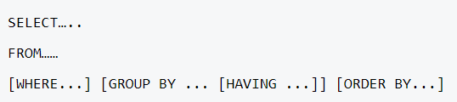

Query Structure
JPQL syntax is very similar to the syntax of SQL.
SQL works directly against relational database tables, records and fields, whereas JPQL works with Java classes and instances.
For example, a JPQL query can retrieve an entity object rather than field result set from database, as with SQL. The JPQL query structure as follows.

Slide 17

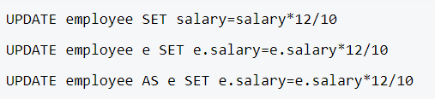
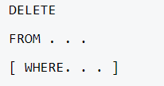
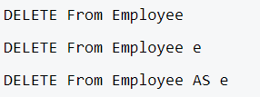
Query Structure

Slide 18

JPQL
JPQL is object-oriented rather than table-oriented.
When we construct String JPQL as
“SELECT x FROM Student x”
The string Student is the name of the entity class, not the table name as in SQL.
So “SELECT x FROM STUDENT x” is wrong unless if there are any entity class with the name STUDENT.

Slide 19
JPA Query API
JPQL offers two methods that are helpful in accessing database records, They are:
Query createQuery(String n): This method is used for query interface instance creation that is used for JPQL statement execution.
Query createNamedQuery(String n): This method is used for query interface instance creation that is used for named queries execution.
TypedQuery<T> : interface which extends Query to query results in a Type Safe manner.

Slide 20
JPA Query API
The Query interface defines two methods for running SELECT queries:
Query.getSingleResult - for use when exactly one result object is expected.
Query.getResultList - for general use in any other case.
Similarly, the TypedQuery interface defines the following methods:
TypedQuery.getSingleResult - for use when exactly one result object is expected.
TypedQuery.getResultList - for general use in any other case.
For UPDATE and DELETE use executeUpdate() method.
The Query interface should be used mainly when the query result type is unknown or when a query returns polymorphic results. When a more specific result type is expected, use the TypedQuery interface.

Slide 21
Practical demo
With Eclipse Maven Project

Slide 22
Thank You
Priyanka Sarode

